Slide 1


Innovative Strategies.
Impeccable Execution.
Firefly Partners: Integrated Digital Marketing Capabilities

Slide 2
We’re passionate about what we do.

Slide 3


Our Company
Founded in 2008 to serve the needs of the nonprofit market
At Firefly Partners, our team is made up of dedicated, personable people
who have a true passion for working with mission-driven organizations.
We focus on delivering modern digital solutions by using proven processes built upon a framework of collaboration, creativity and communication.
Our team enjoys working together to solve challenging problems for clients and the company. As a result, our clients are provided with the highest quality deliverables and the best experience possible, and that makes us all feel incredibly proud.

Slide 4
Our Approach
We identify opportunities and solve problems.
We use a comprehensive set of metrics to evaluate your baseline performance, set new goals and develop a detailed strategy to help you reach those goals.
We deliver innovative solutions to meet your requirements, and provide ongoing monitoring and adjustment for increased conversion.
We leverage the power of time-tested best practices across all of your digital channels, and apply the latest in modern communication and conversion tactics for content that resonates with your audiences.

Slide 5
We deliver the right services.

Slide 6

The Best Story Still Needs A Smart Strategy

Slide 7
Strategy & Planning
Marketing Metrics Analysis and Recommendations
User Surveys and Usability Testing
Communication Audits and Content Strategy
Multichannel Campaign Planning
Google Grants and AdWords
Click Tracking Analysis: Mothers Against Drunk Driving

Slide 8

Integrated Digital Marketing Services
Social Media Marketing
Search Engine Optimization (SEO)
Email, Fundraising and Advocacy Campaign Execution
A/B Testing
Copywriting and Editing
Social Media Ad: National Marrow Donor Program

Slide 9

Design Services
UX Design and Prototyping
Website Design
Email Design
Impression and Social Media Ads
Corporate Sponsorship Collateral
Lightbox Design: Energy Outreach Colorado

Slide 10
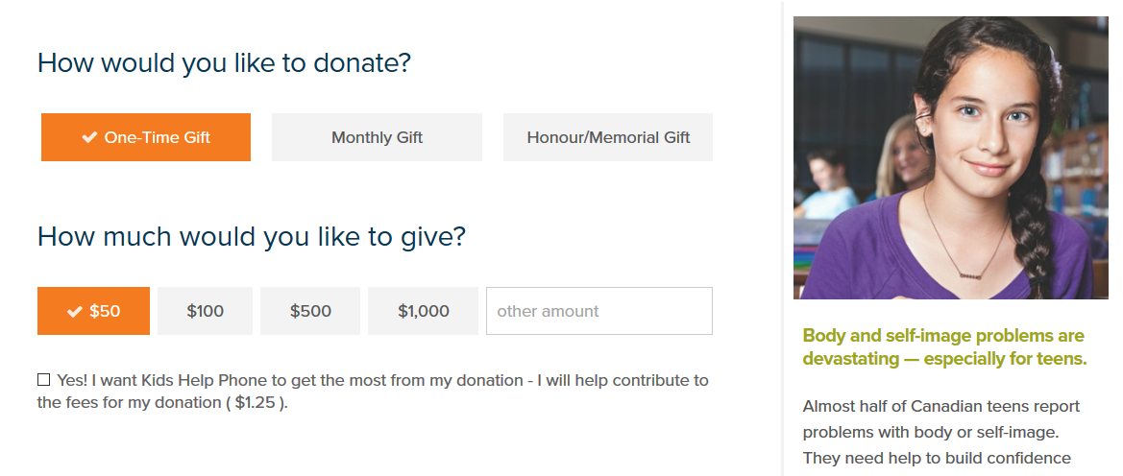
Technical Development Services
Responsive Website Development
Fundraising and Communication Software Implementation
Custom Solution Research and Programming
Salesforce Integration
Google Analytics Configuration
English/French Donation Form: Kids Help Phone

Slide 11










We Use Modern Software

Slide 12
We develop lasting partnerships.

Slide 13

























Average renewal rate of 85% since 2008

Slide 14


“In my entire career, I've never worked with such a fantastic vendor as Firefly! The customer support and level of help is unsurpassed! Your team is the key to our online success.”
“I am so glad that I found Firefly! I am delighted with the entire experience from start to finish – couldn’t be happier.”
“Firefly’s extensive experience with and understanding of Luminate and its real-world uses has made them an invaluable partner and resource throughout this project.”
Jenny Stewart,
NCLR
Kathy Tobin
Baystate Medical Foundation
Christine Ware,
Living Beyond Breast Cancer

Slide 15
We help to change the world.

Slide 16
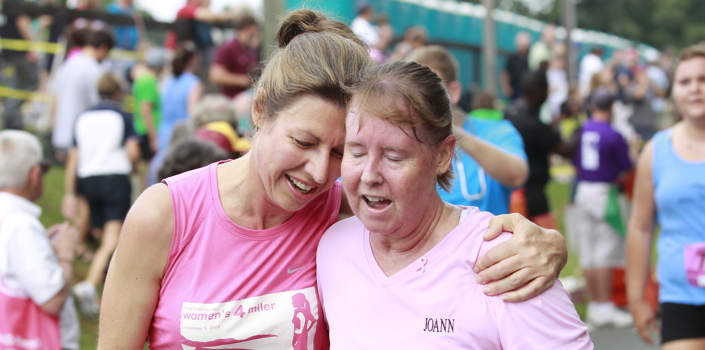
UVA Cancer Center

Slide 17
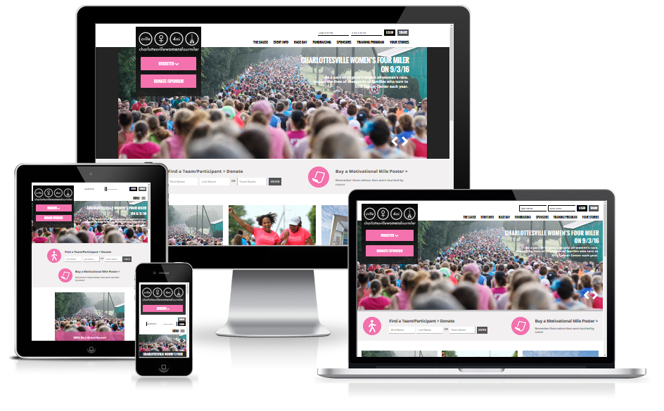
UVA Cancer Center
UVA Cancer Center: Peer-to-Peer Microsite
A Comprehensive Approach
  Strategic Planning
  Design and Development
  Streamlined Registration
  Participant Communication
  Performance Metrics
“The staff at Firefly helped us with a complex project that had a tight deadline. They listened to our needs and produced a site that was beautiful and engaging. We’re now working on our 5th project with Firefly and couldn’t be happier!’

Slide 18

American Kidney Fund

Slide 19
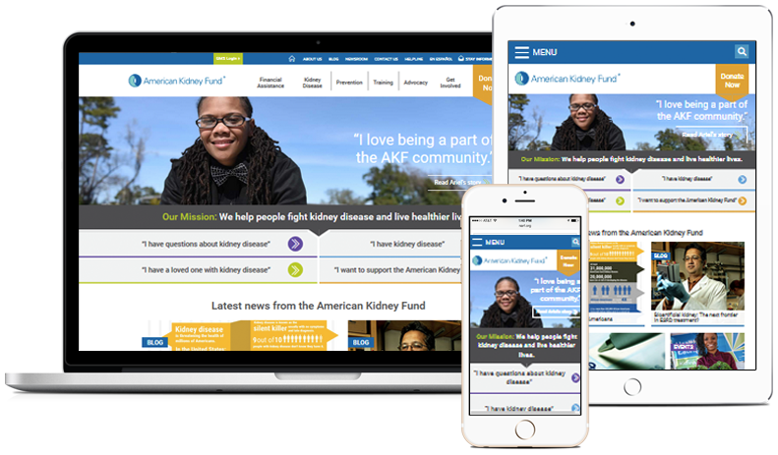
American Kidney Fund: Award-Winning Presence
Sophisticated Usability Testing
  Wireframe Prototyping
  User Personas
  Conditional Content
  Social Media Promotion
  High Conversion Rates
“Our experience with Firefly designing and developing our new responsive website was outstanding from start to finish. The end product is a beautiful, intuitive site that effectively communicates our lifesaving mission. Our audience loves it!”

Slide 20
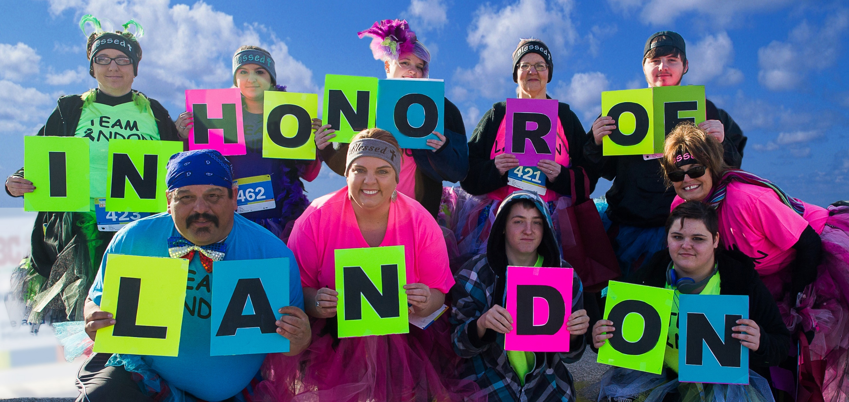
Be The Match/National Marrow Donor Program

Slide 21
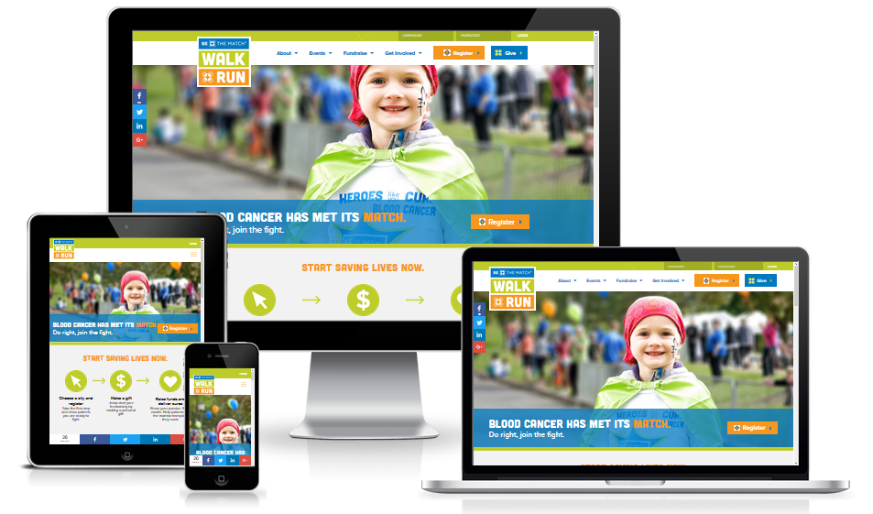
Be The Match: Be The Match Walk + Run
Redesign for Signature Event
  Performance Analysis
  Reengagement Strategy
  Design & Development
  Participant Email Content
  Social Media Integration
“It’s rare to find a vendor that 'gets you' the way Firefly does. No matter what we throw at them, they never fail to mold our crazy ideas, budget restrictions and timelines into inspired solutions. Firefly is not just a vendor for us, they’re part of our team.”

Slide 22

Contact Us For A Custom Quote.
860-383-8332 | maureen@fireflypartners.com

